Slide 1
Network Security Project
MORNITORING NETWORK TRAFFIC
BY: Y@h@ck5 +2348140879281

Slide 2
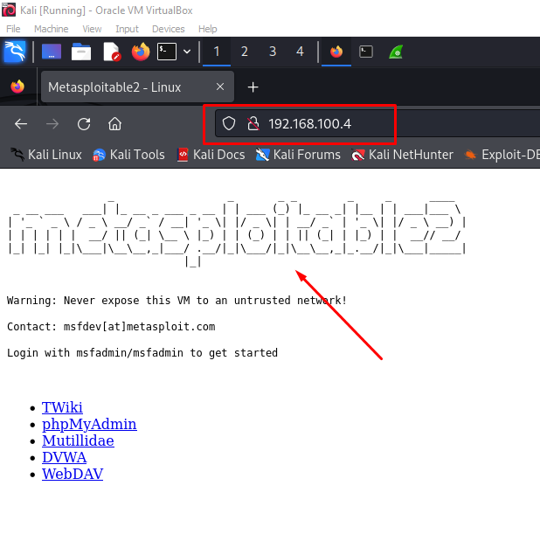
Performing Network Activities
As expected the client(Kali) makes request to the server. Typed the IP address of the server(Metasploitable2) which is 192.168.100.4 in the URL box of a broser then hit Enter.
The Server returns a webpage, we noticed some information about the websites and few links.

Slide 3
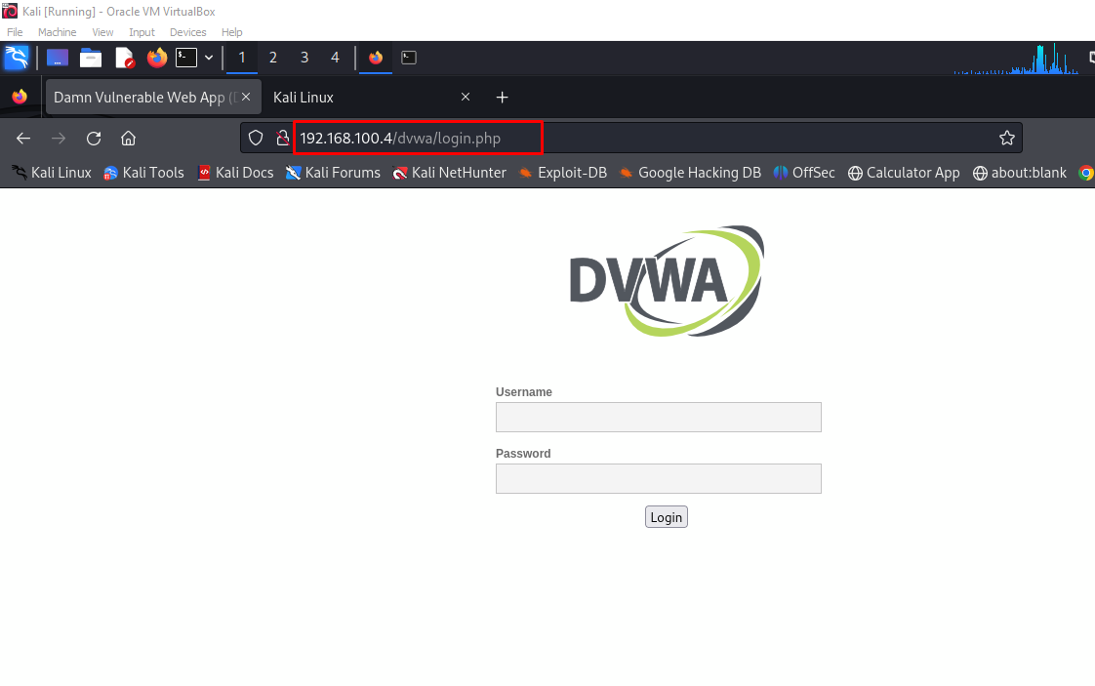
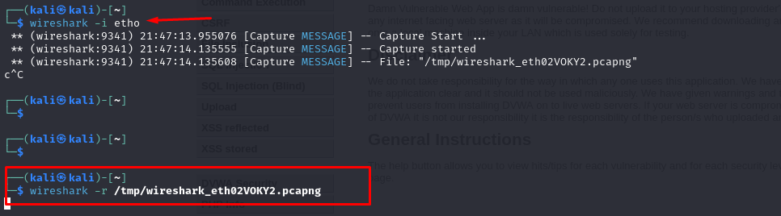
Damn Vulnerable Website Application
Click on DVWA link on the homepage and it takes us to login page with the logo DVWA . As seen in the image.
While doing so I started the wireshark tool in the background using the command: wireshark -i eth0

Slide 4
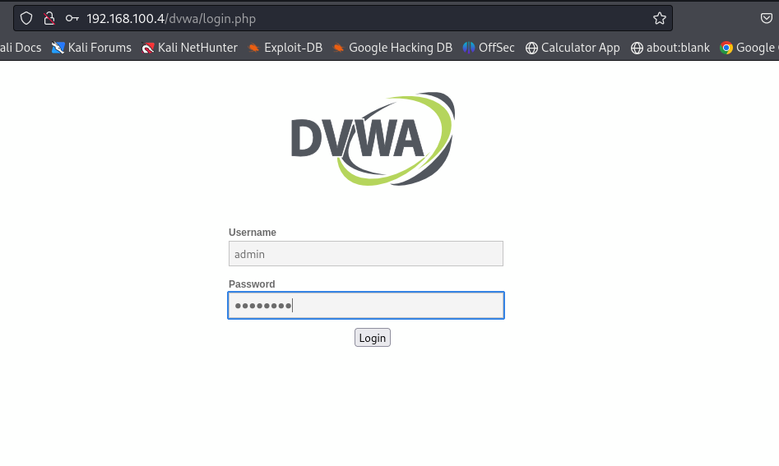
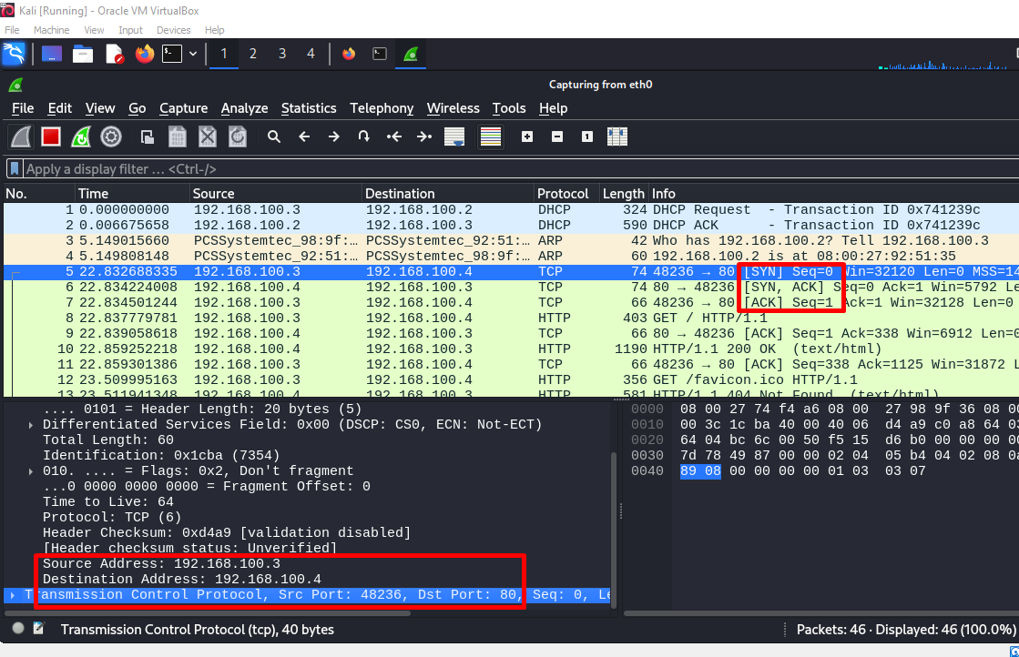
Mornitoring the Traffic
While wireshark runs in the background, logged in using admin as username and password as password.

Slide 5
Analze the Captured Traffic
In the client terminal type ctrl c to stop the wireshark capture. As seen in image the capture was saved in /tmp/wirecap.pcapng.
Type wireshark -r /tmp/wirecap.pcapng as seen to analyze the captured file from our previous activies.

Slide 6
Identifying Key Threats & Suspicious Activities
Wireshark windows is opened from the previous command so that we can analyze the captured traffic and identify potential threaths or suspicious activies.
I use the filter ip.addr==192.168.100.4 to filter results only for the server(Metasplotable2), looked for POST request as credentials are sent using posts by the application. And here I noticed that the credentials are sent in clear text which is a potential threats. Attackers could leverage this if found in a production enviroment. See Next Slide.

Slide 7
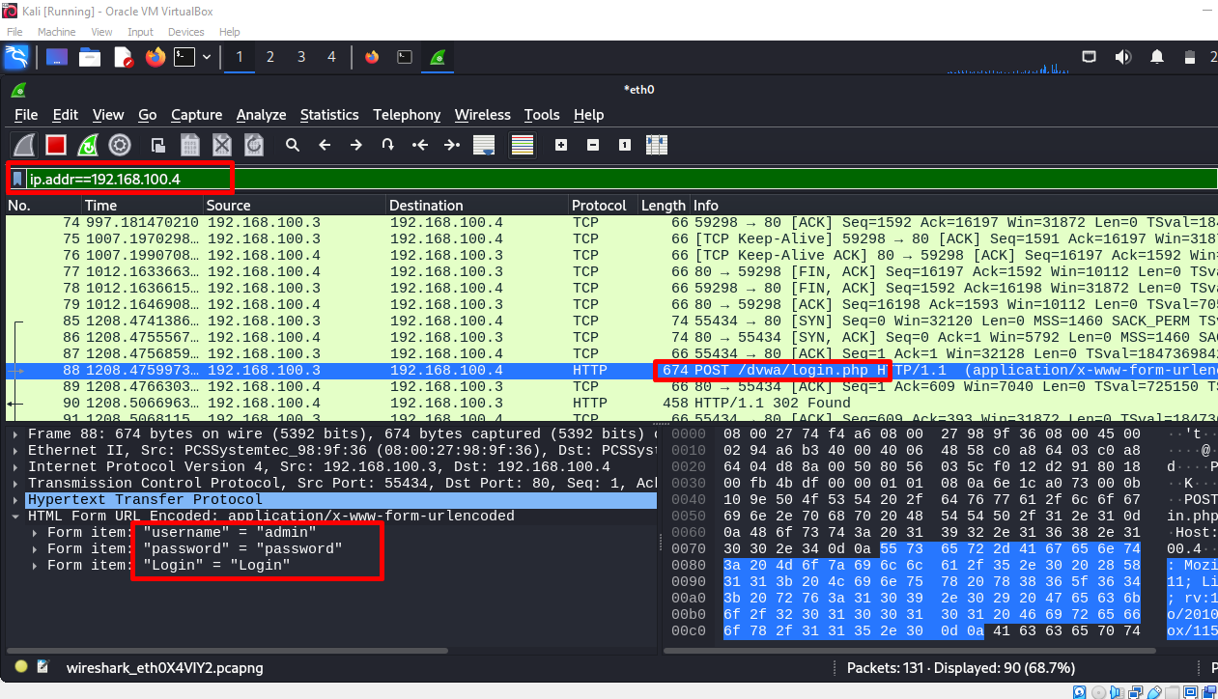

Slide 8
THANKS
NEXT:HARDEN THE SERVER

